Slide 1
Thomas G. Harris Elementary
Jesse Mondragon

Slide 2

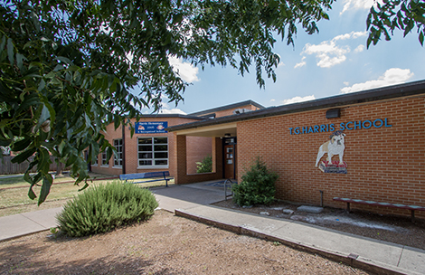
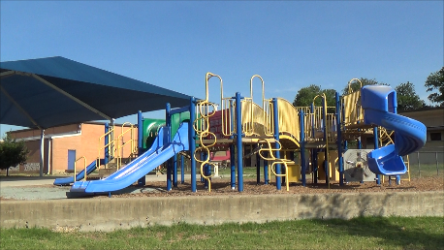
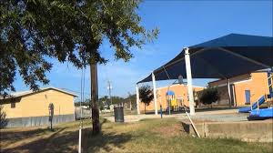
1711 Wheless Ln, 78723
Pre Kinder – 5th Grade

Slide 3
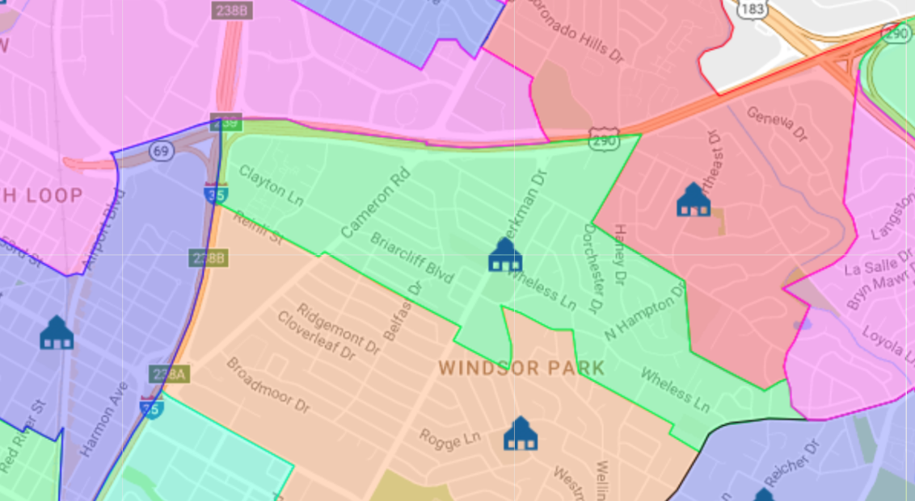
School Boundaries

Slide 4
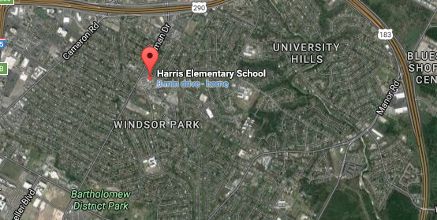
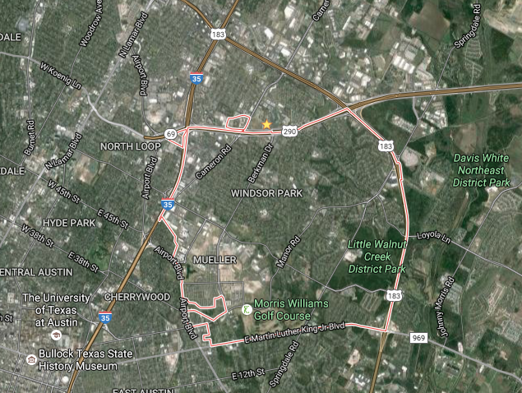

Google Maps: Satellite View
Notes:
Harris Elementary: 4.5 miles from UT

Slide 5
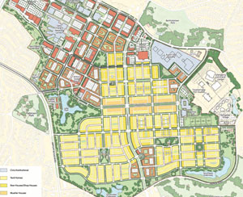
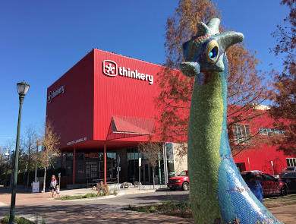
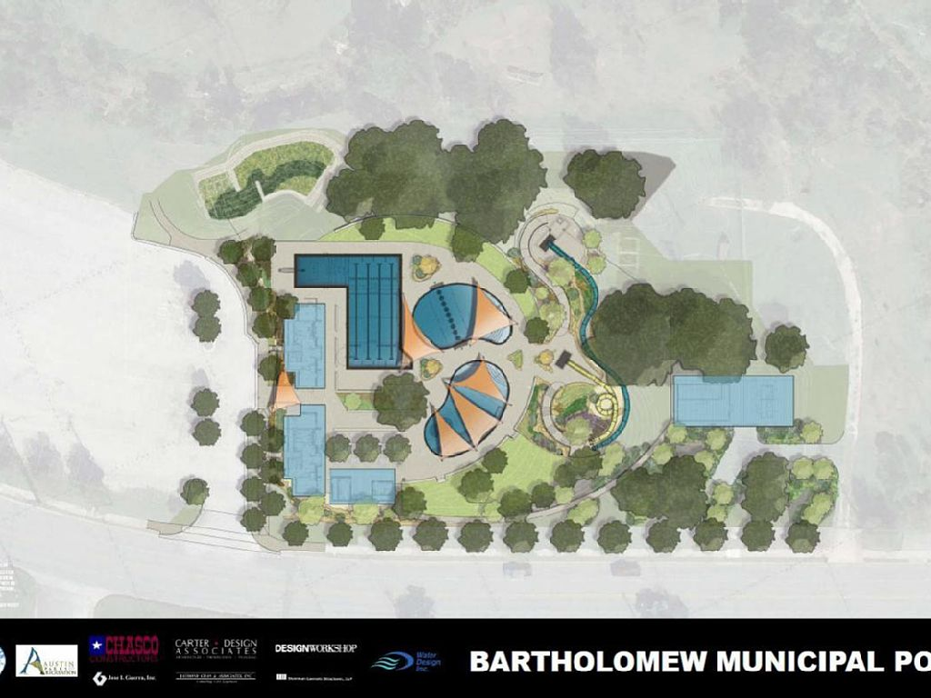
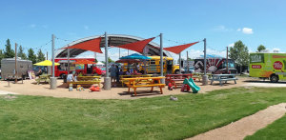
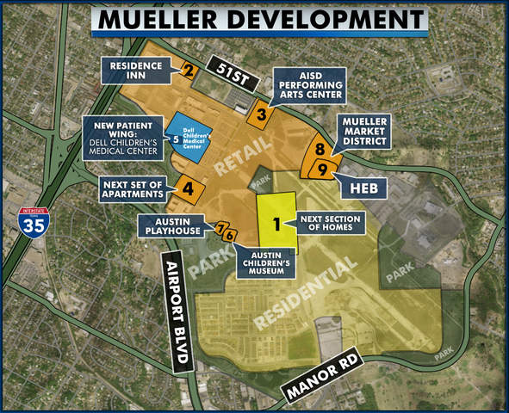
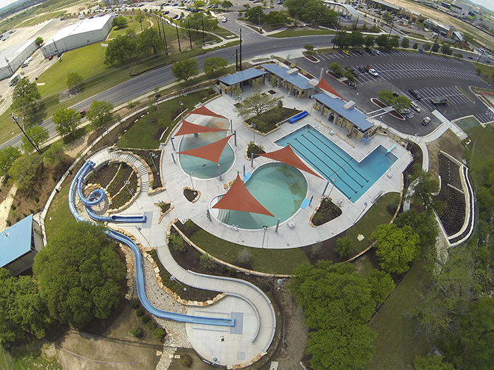
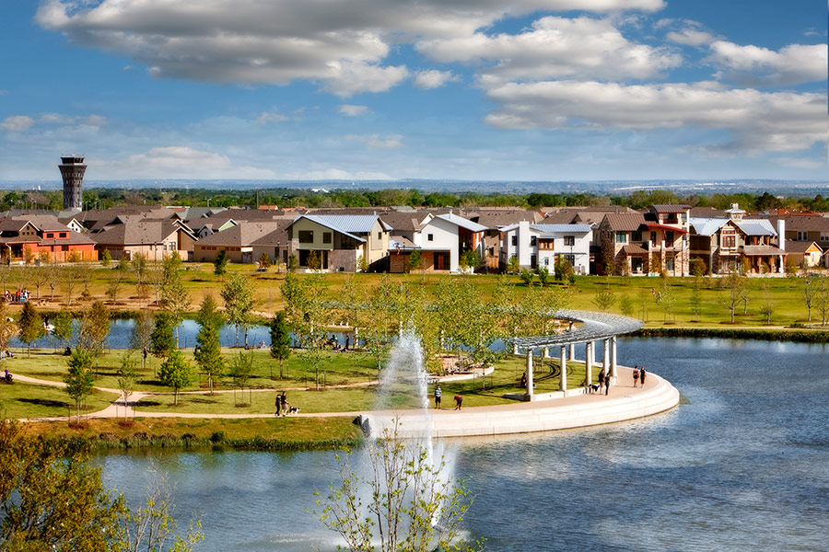
The Community: Recreational
Windsor Park Community 78723
Notes:
Concentrated in Mueller
Bartholomew Park: .9 miles away from Harris
Mueller Park: 1.9 miles away from Harris

Slide 6
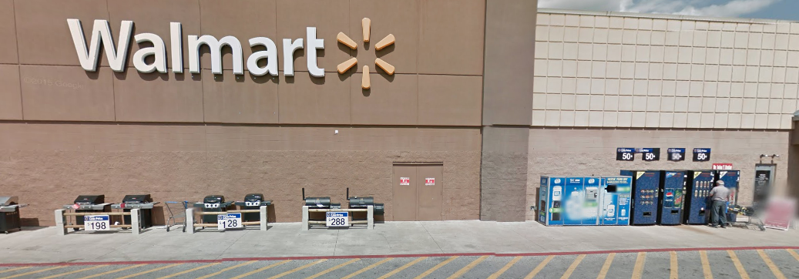
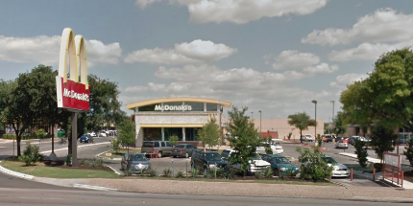
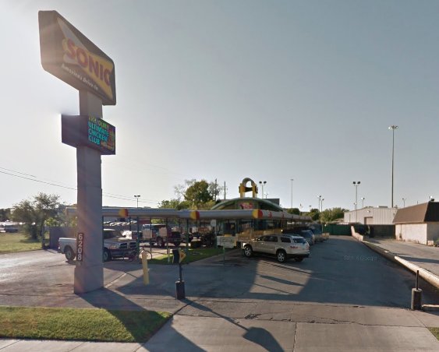
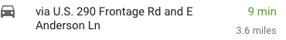
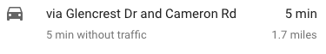
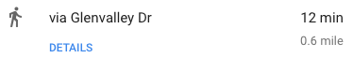
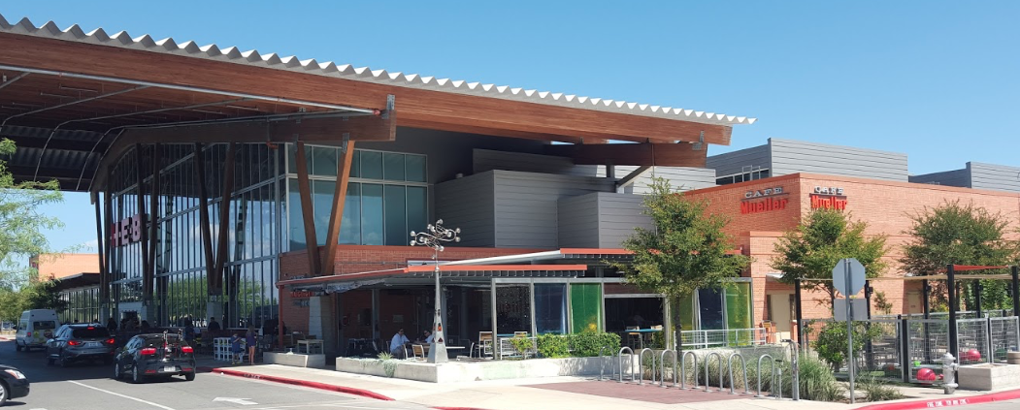
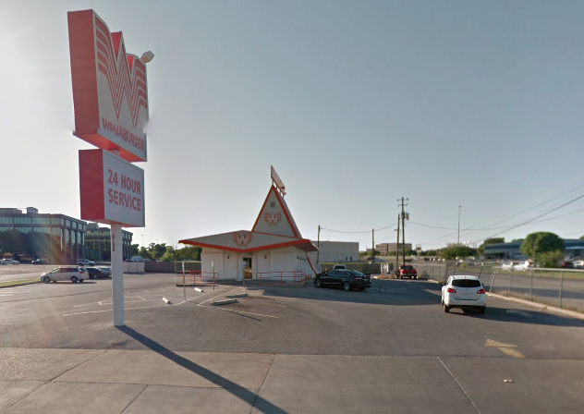
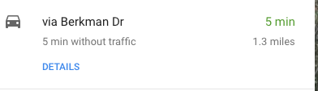
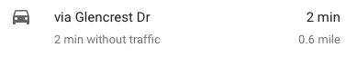
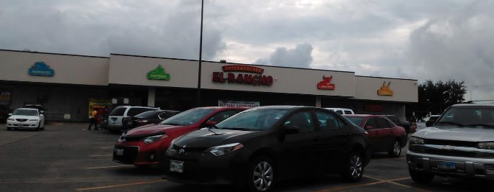
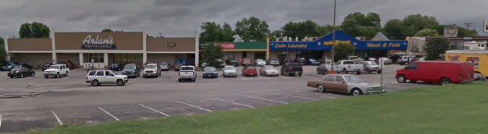
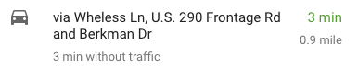
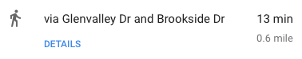
The Community: Businesses
Windsor Park Community 78723
Notes:
Not as developed as you go north; not many stores, except for Capital Plaza and Mueller Shopping Center

Slide 7
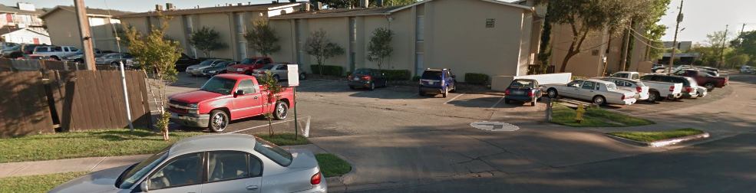
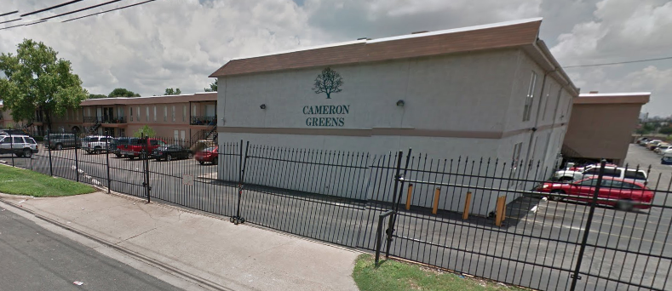
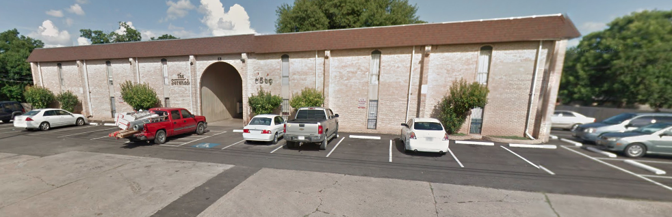
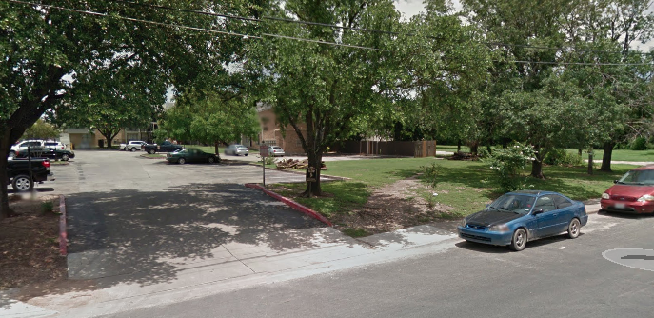
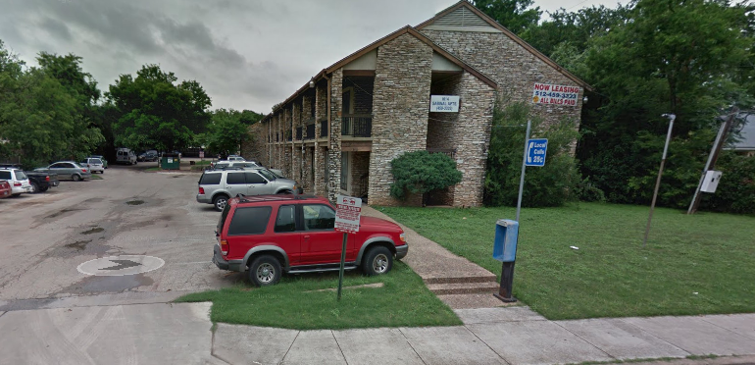
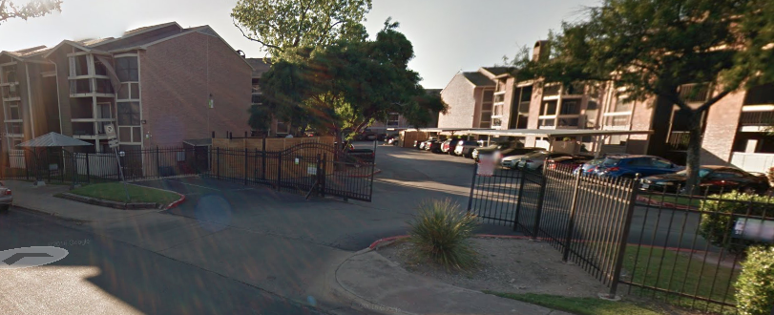
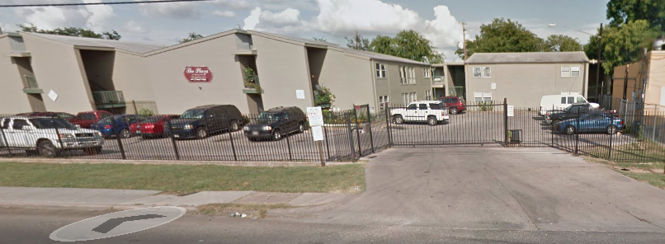
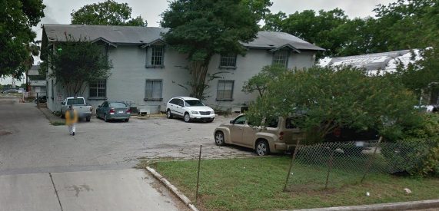
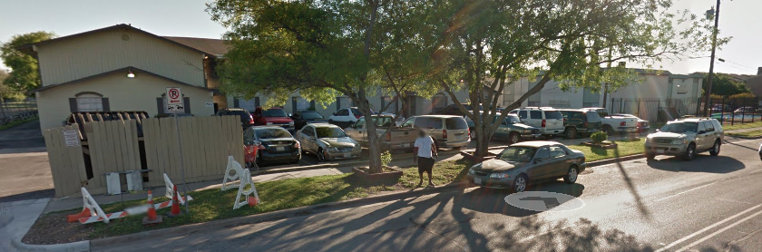
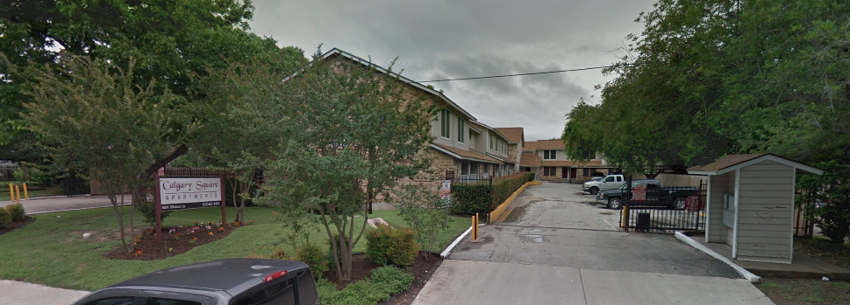
The Community: Living
Windsor Park Community 78723
2013 Statistics: (Austin)
10 Apartment Complexes^{[1]} Median Age: 32.1 ^{[5]}
Population: ~31,234 ^{[4]} Average Listing Price: $389,400
Median Rent: $791 ($863)^{[1]}
Pop. Below Poverty: 26.4% (17.8%)^{[1]}
Holds 9.2% City’s Homeless Population^{[3]}
Notes:
Rapid change in Demographics/ decline in African Americans

Slide 8
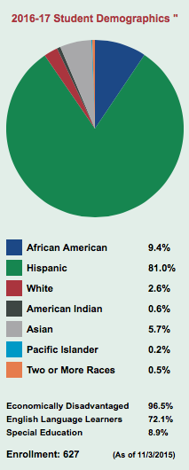
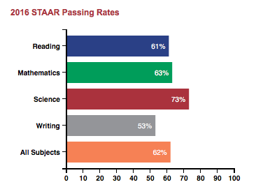
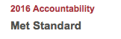
Harris Elementary: Stats
Principal: Monica Martinez
Notes:
627 Students; 76 Staff and Administrators; including 54Teachers.
Source: http://harriselem.tx.aie.schoolinsites.com/?PageName='Teachers’

Slide 9
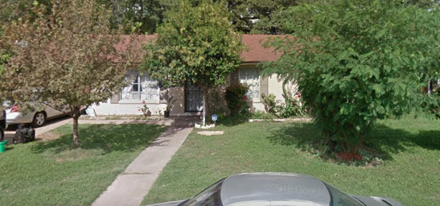
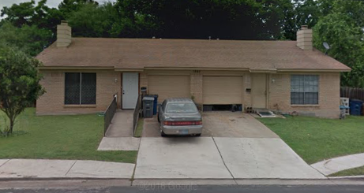
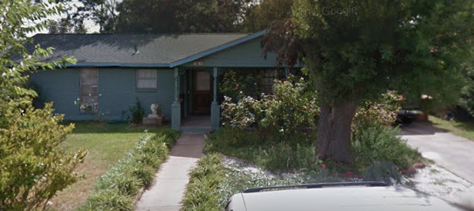
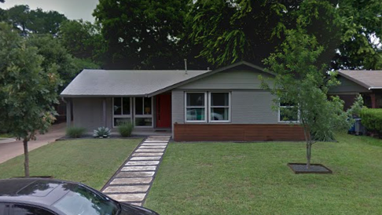
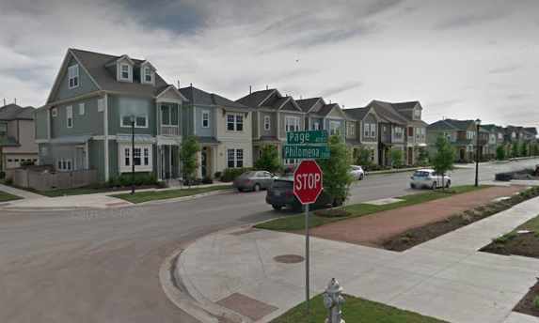
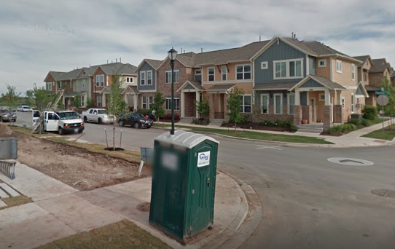
The Community: Living
Windsor Park Community 78723
2013 Statistics: (Austin)
Homes: 6927 ^{[1]}
Median Family Income: $41, 207 ^{[3]}
Median Family Incomes:
^{[4]}
Less than $10,000 | 584
$10,000 to $14,999 | 422
$15,000 to $24,999 | 787
$25,000 to $34,999 | 897
$35,000 to $49,999 | 792
Notes:
3,482 Families Incomes below $50k mark

Slide 10
Fast Stats: Windsor Park
Education Stats: [Austin]
No High School: 3,313(22%) [9%]
Some High School: 1,722(11%)[8%]
Some College: 3,873(26%)[23%]
Assoc. Degree: 494(3%)[7%]
Bachelor’s Degree: 3,611(24%)[34%]
Graduate Degree: 2,036 (14%)[20%]
Professions:
Education
Business/Management
Construction
Retail
Food Services
Technology
Median Household Income: $42,939
2,370 Households with Social Security Assistance ^{[4]}
Average Household Size: 3
3,036 Households with Cash Public Assistance ^{[4]}
2,571 Households with Food Stamp Benefits in the last 12 months ^{[4]}
2 Parents, 1 Child: $47,556 ^{[6]}
2 Parents, 2 Children: $55,370 ^{[6]}
1,516 Civilians registered as unemployed ^{[4]}
2 Parents, 2 Children: $65,233 ^{[6]}
8,837 Identified as Under the Poverty Line ^{[4]}
Notes:
3,673 under 18 yrs of age in poverty
Education

Slide 11
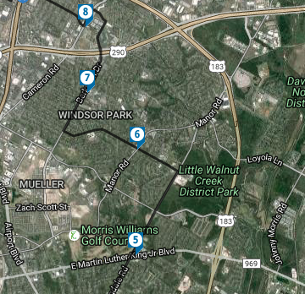
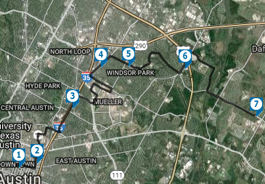
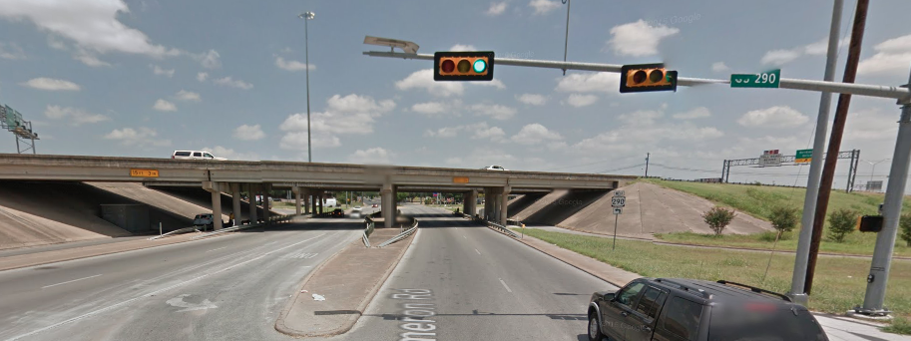
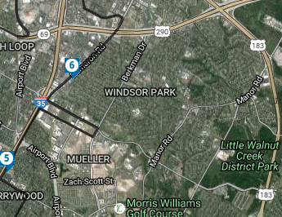

The Community: Transportation
Windsor Park Community 78723
Notes:
Major Streets: Berman Dr, Cameron Rd, and 51st St
Major Highways: 183 and I 35
Bus Routes: 37, 300, 320
300 (Crosstown): Spring 2013 Averaged 6,400 during the week (3rd most used)

Slide 12









The Community: Social Services
Windsor Park Community 78723
Notes:
Social Services Around a 3 miles zone

Slide 13



Average Home Listings
Notes:
Population Spike in 2000
Demographic Change:
Average home listing in Ausitn: ~$500k; Windsor Park $389,400 (proximity to city)

Slide 14
Sources:
http://www.city-data.com/neighborhood/Windsor-Park-Austin-TX.html
https://maps.google.com/
http://housingworksaustin.org/wp-content/uploads/2014/12/2014-District-Analyses.pdf
http://www.austintexas.gov//page/demographic-data
http://www.towncharts.com/Texas/Demographics/78723-Zipcode-TX-Demographics-data.html
http://livingwage.mit.edu/counties/48015

